Slide 1
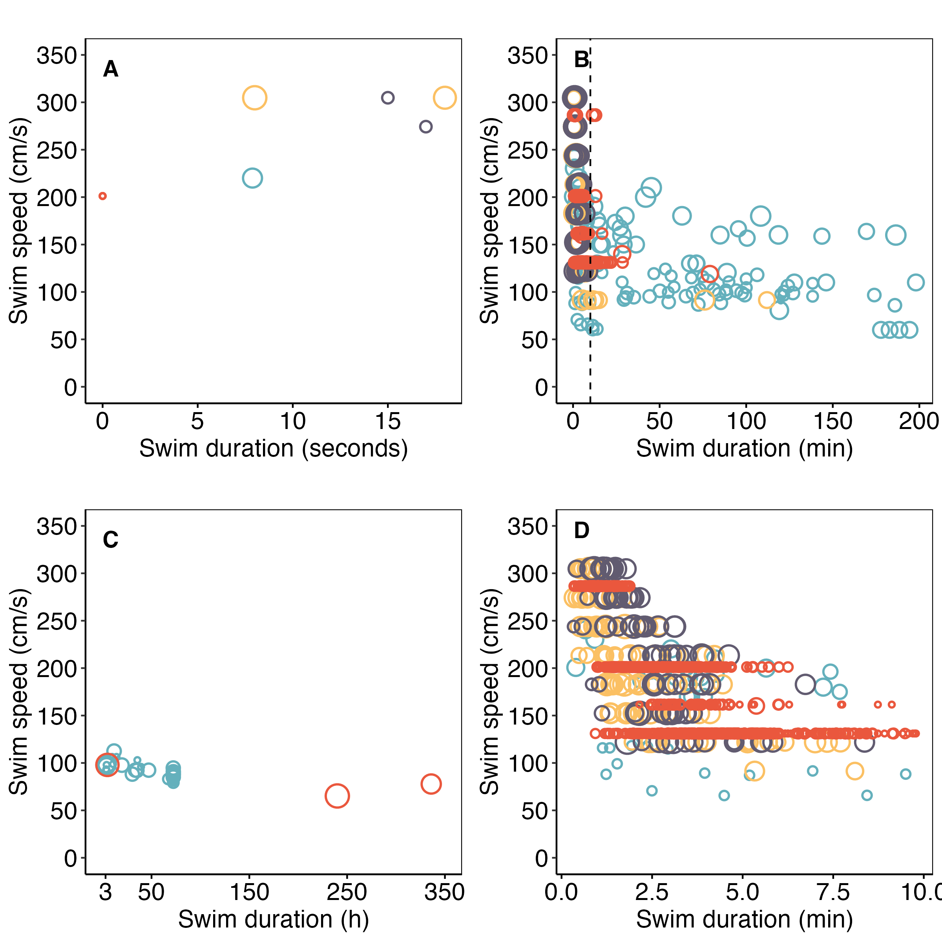

UNSTEADY
(anaerobic, and aerobic)
BURST (anerobic)
STEADY (aerobic)

Slide 2
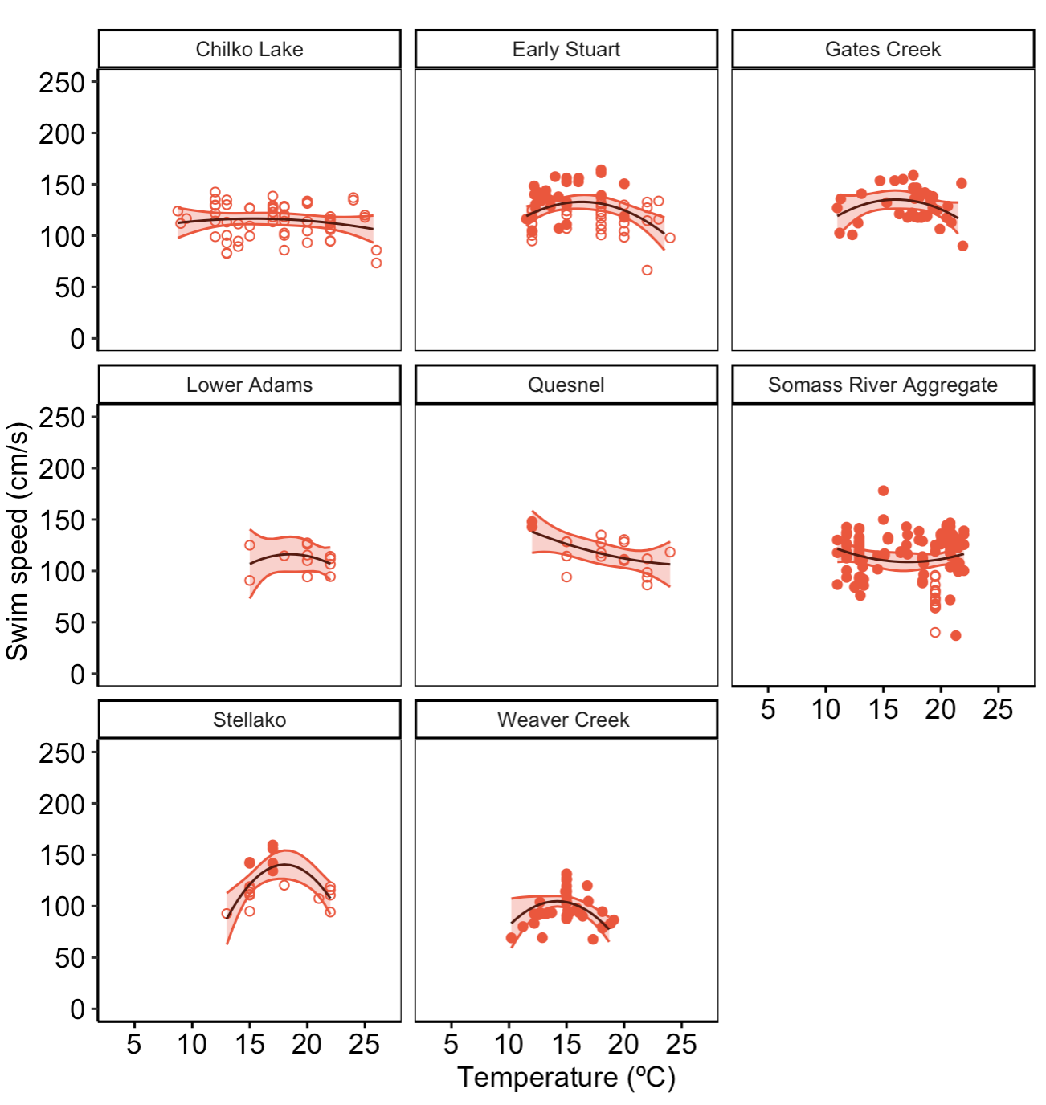

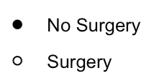
O. nerka
Panels = populations

Slide 3
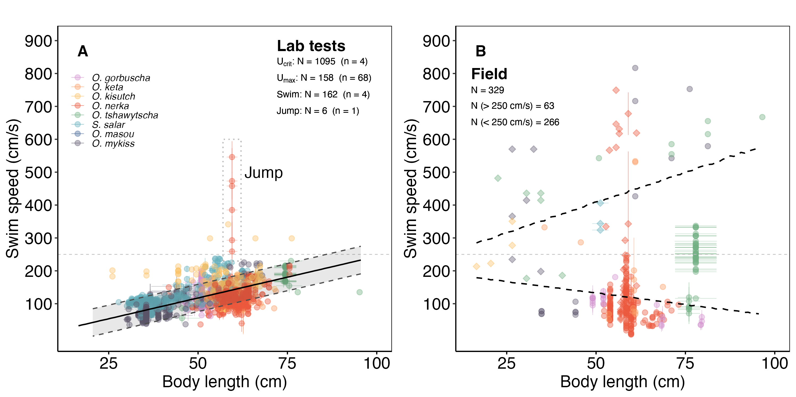
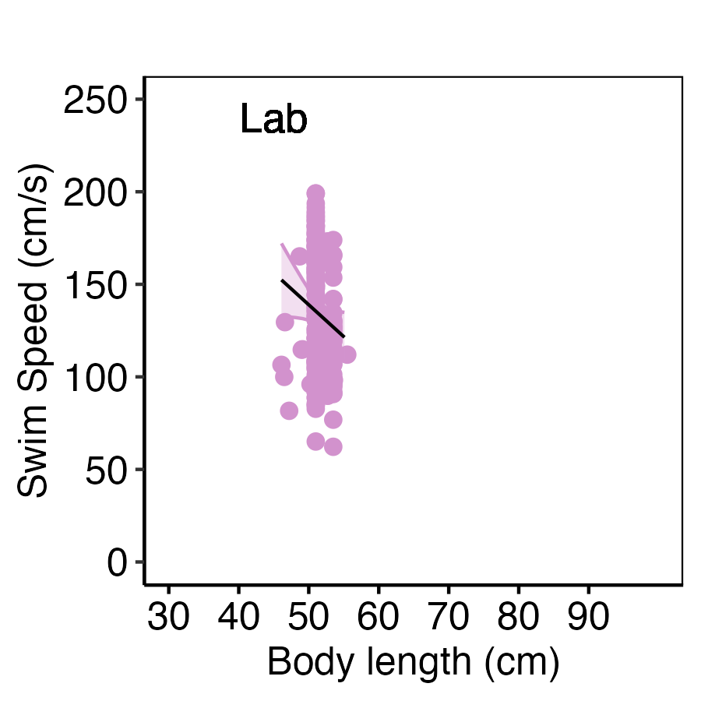
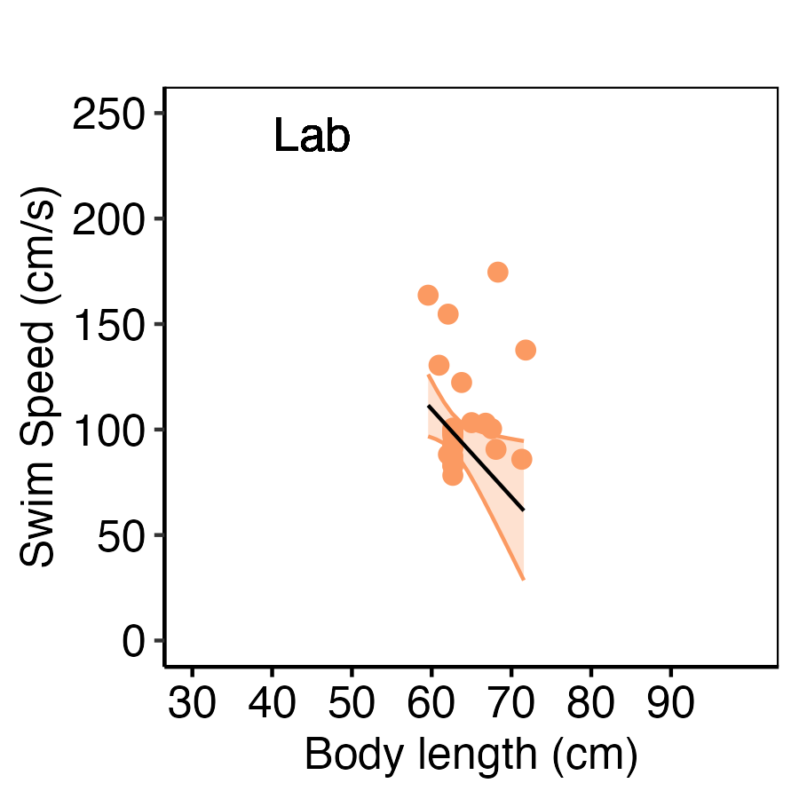
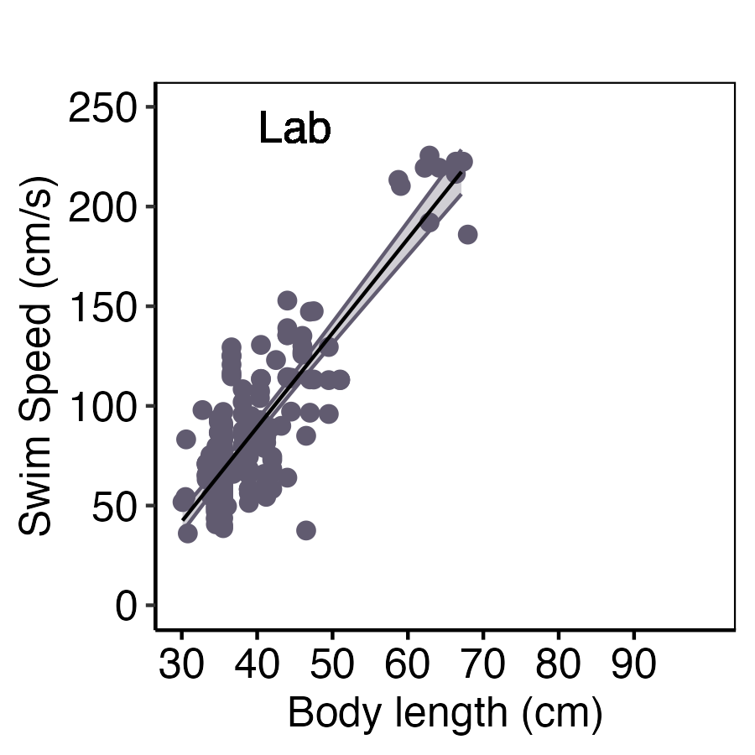
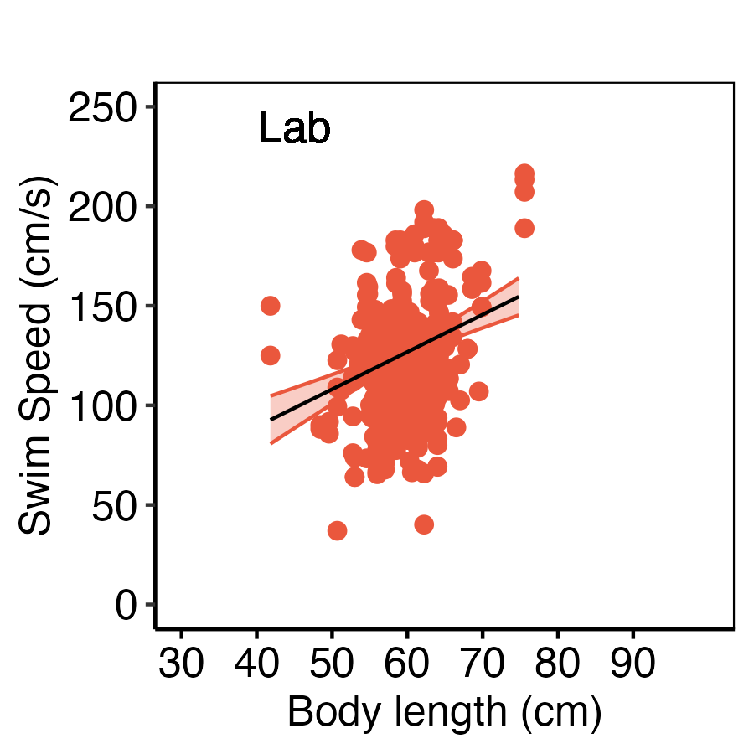
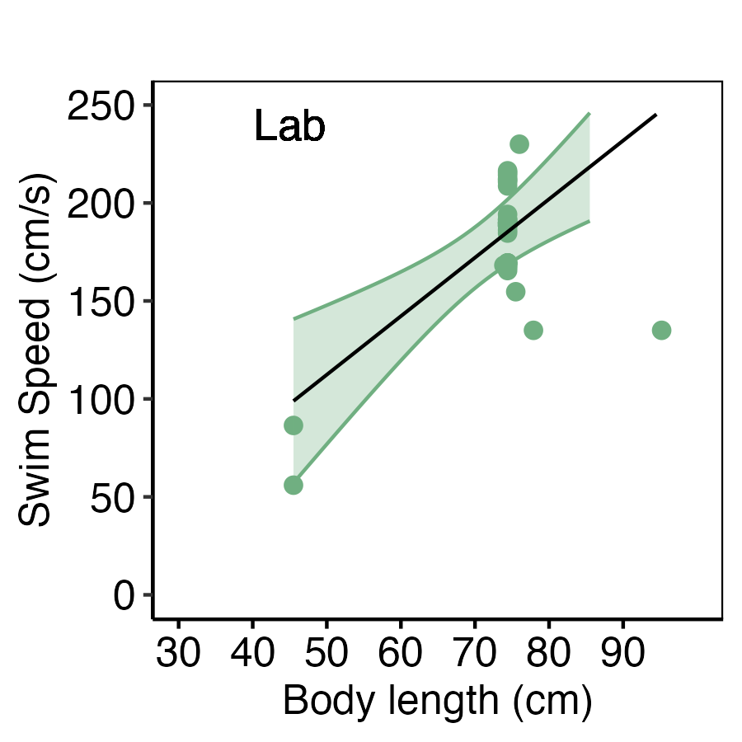
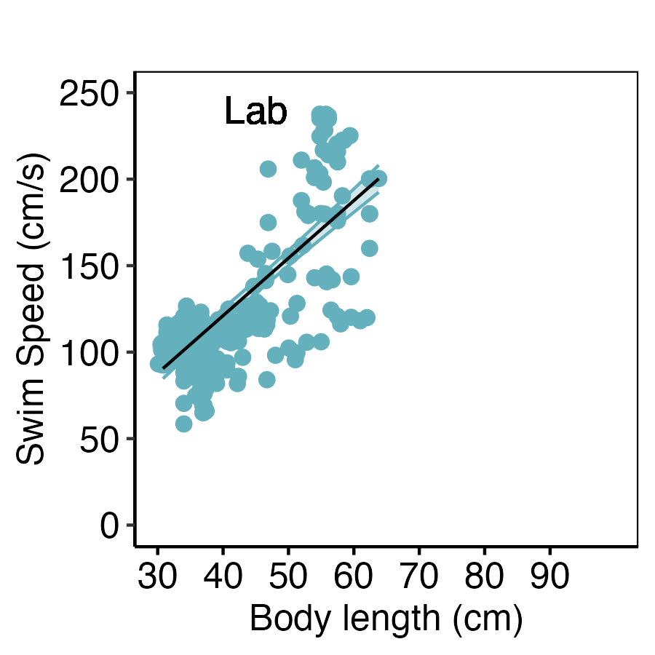
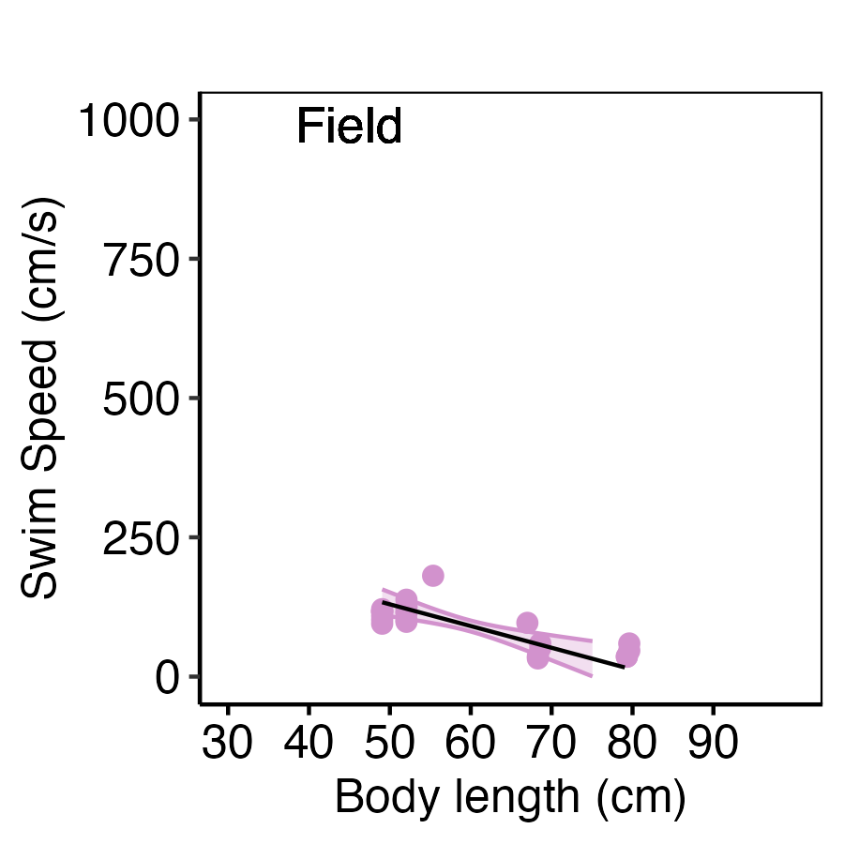
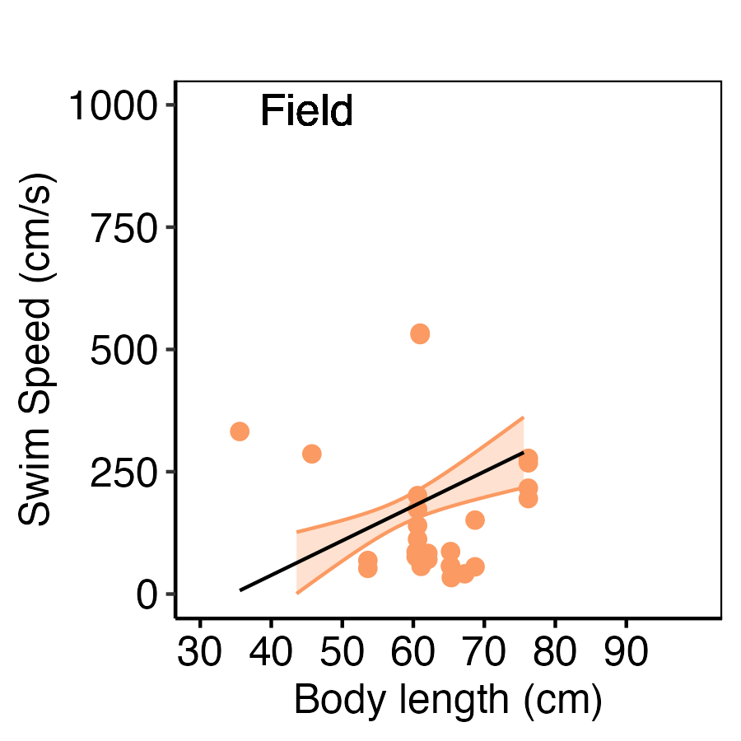
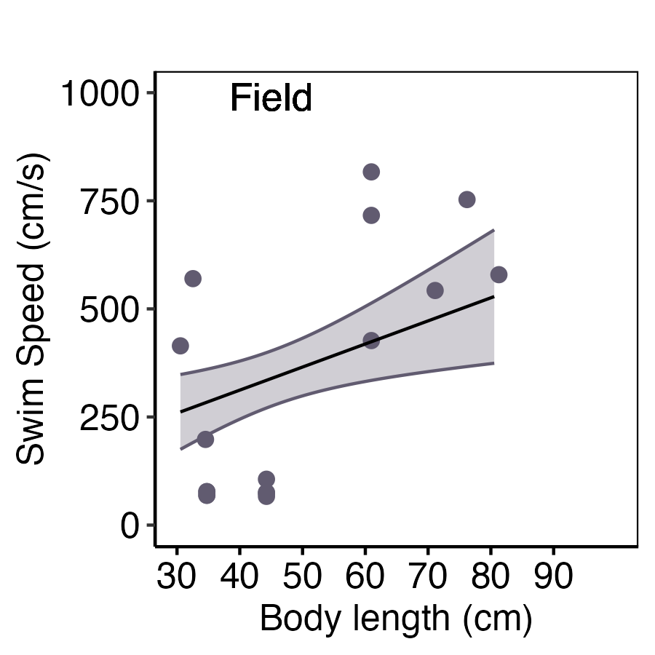
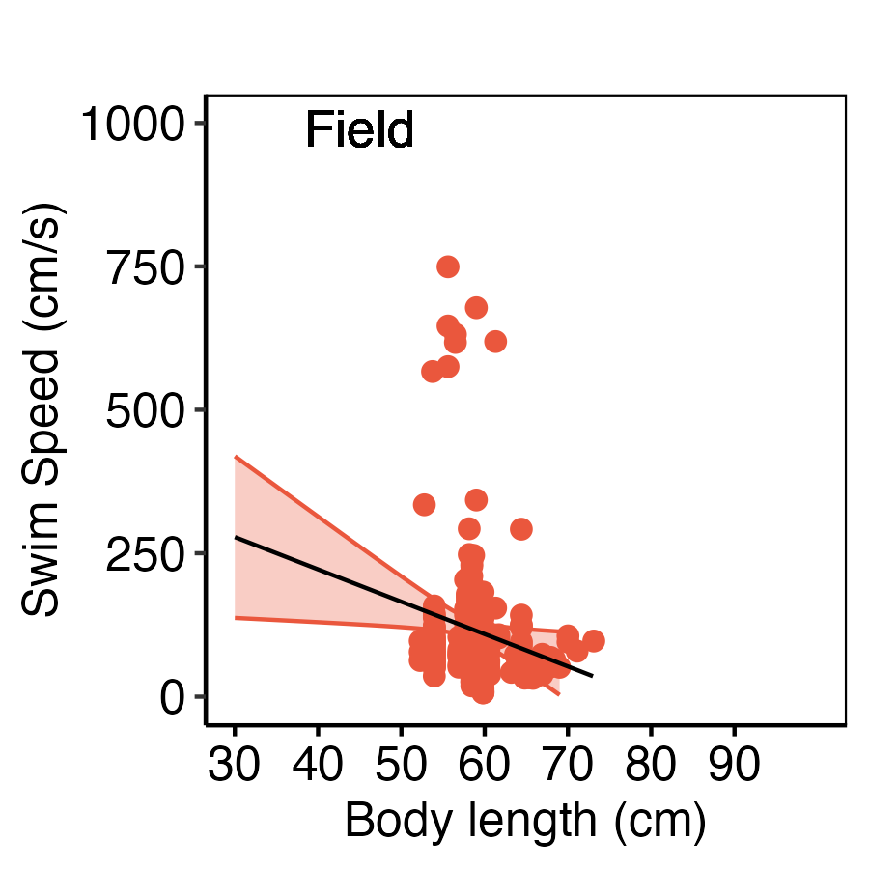
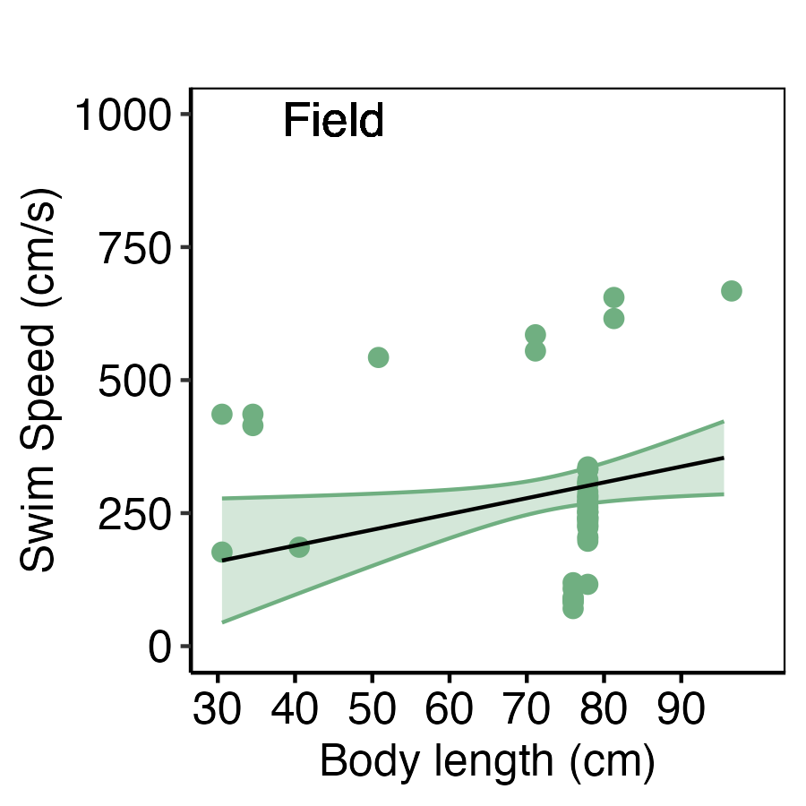
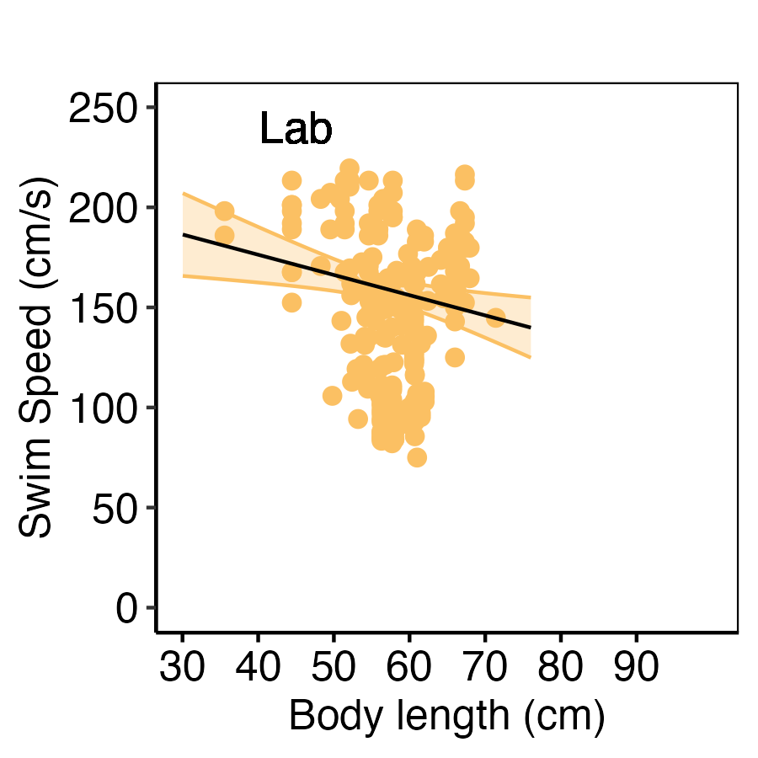
C

Slide 4
HOW WAS the DATA COLLATED (roadmap)
Option 1: plot only with Ucrit (mo2 ~ speed) trend, then I took the highest speed shown
Option 2: author reported calculated Ucrit speed (not just the highest speed, this follows the typical Ucrit calculation).

Slide 5



Learning from literature synthesis
Hinch and Bratty 2000
Fallback
Pass
burst
burst
Swim speed
Time
ANAEROBIC SWIMMING
(Fraser River Canyon, Hell’s Gate, Big Bar Rockslide)
RECOVERY
(re-establish physiological homeostasis after anaerobic swimming)
What is maximum reported swimming capacity in salmon?
57 % (50/87) of swim studies addressed recovery
87 Studies on Salmon swimming
52 Studies on Pacific Salmon
46 % (23/50)
Studied Recovery
54 % (27/50)
Discussed Only
Chinook salmon: 668 cm/s, 1.9 BL/s
Chum salmon: 533 cm/s, 3.32 BL/s
Pink salmon: 147 cm/s 3.90 BL/s
Sockeye salmon: 546 cm/s, 13.5 BL/s
Coho salmon: 187 cm/s, 4.25 BL/s
Blood Biochemistry
Metabolism
Cardiac physiology
Somatic Energy
Swim
Repeat Swim
(recovery
ratio)
Fatigue swim speeds
78 % (18/23)
87 %
(20/23)
43 %
(10/23)
26 %
(6/23)
How much is too much bursting (leads to fallback, or delayed mortality?)
83 %
(19/23)
30 %
(7/23)
Notes:
How is body size shaping the optimal swimming – bursting performance and recovery performance? Are there any detectable trade-offs from the field study?

Slide 6
POST SWIM RECOVERY
(re-establish physiological baseline after aerobic and anaerobic swimming)
57 % (52/91) included studies addressed recovery
56 % (29/52)
discussed
PERFORMANCE EXAMINED:
Blood (18/23)
Heart (11/23)
Metabolism (18/23)
Somatic energy (6/23)
Repeat Swim (recovery ratio) (19/23)
46 % (23/52)
studied recovery
Notes:
How is body size shaping the optimal swimming – bursting performance and recovery performance? Are there any detectable trade-offs from the field study?

Slide 7
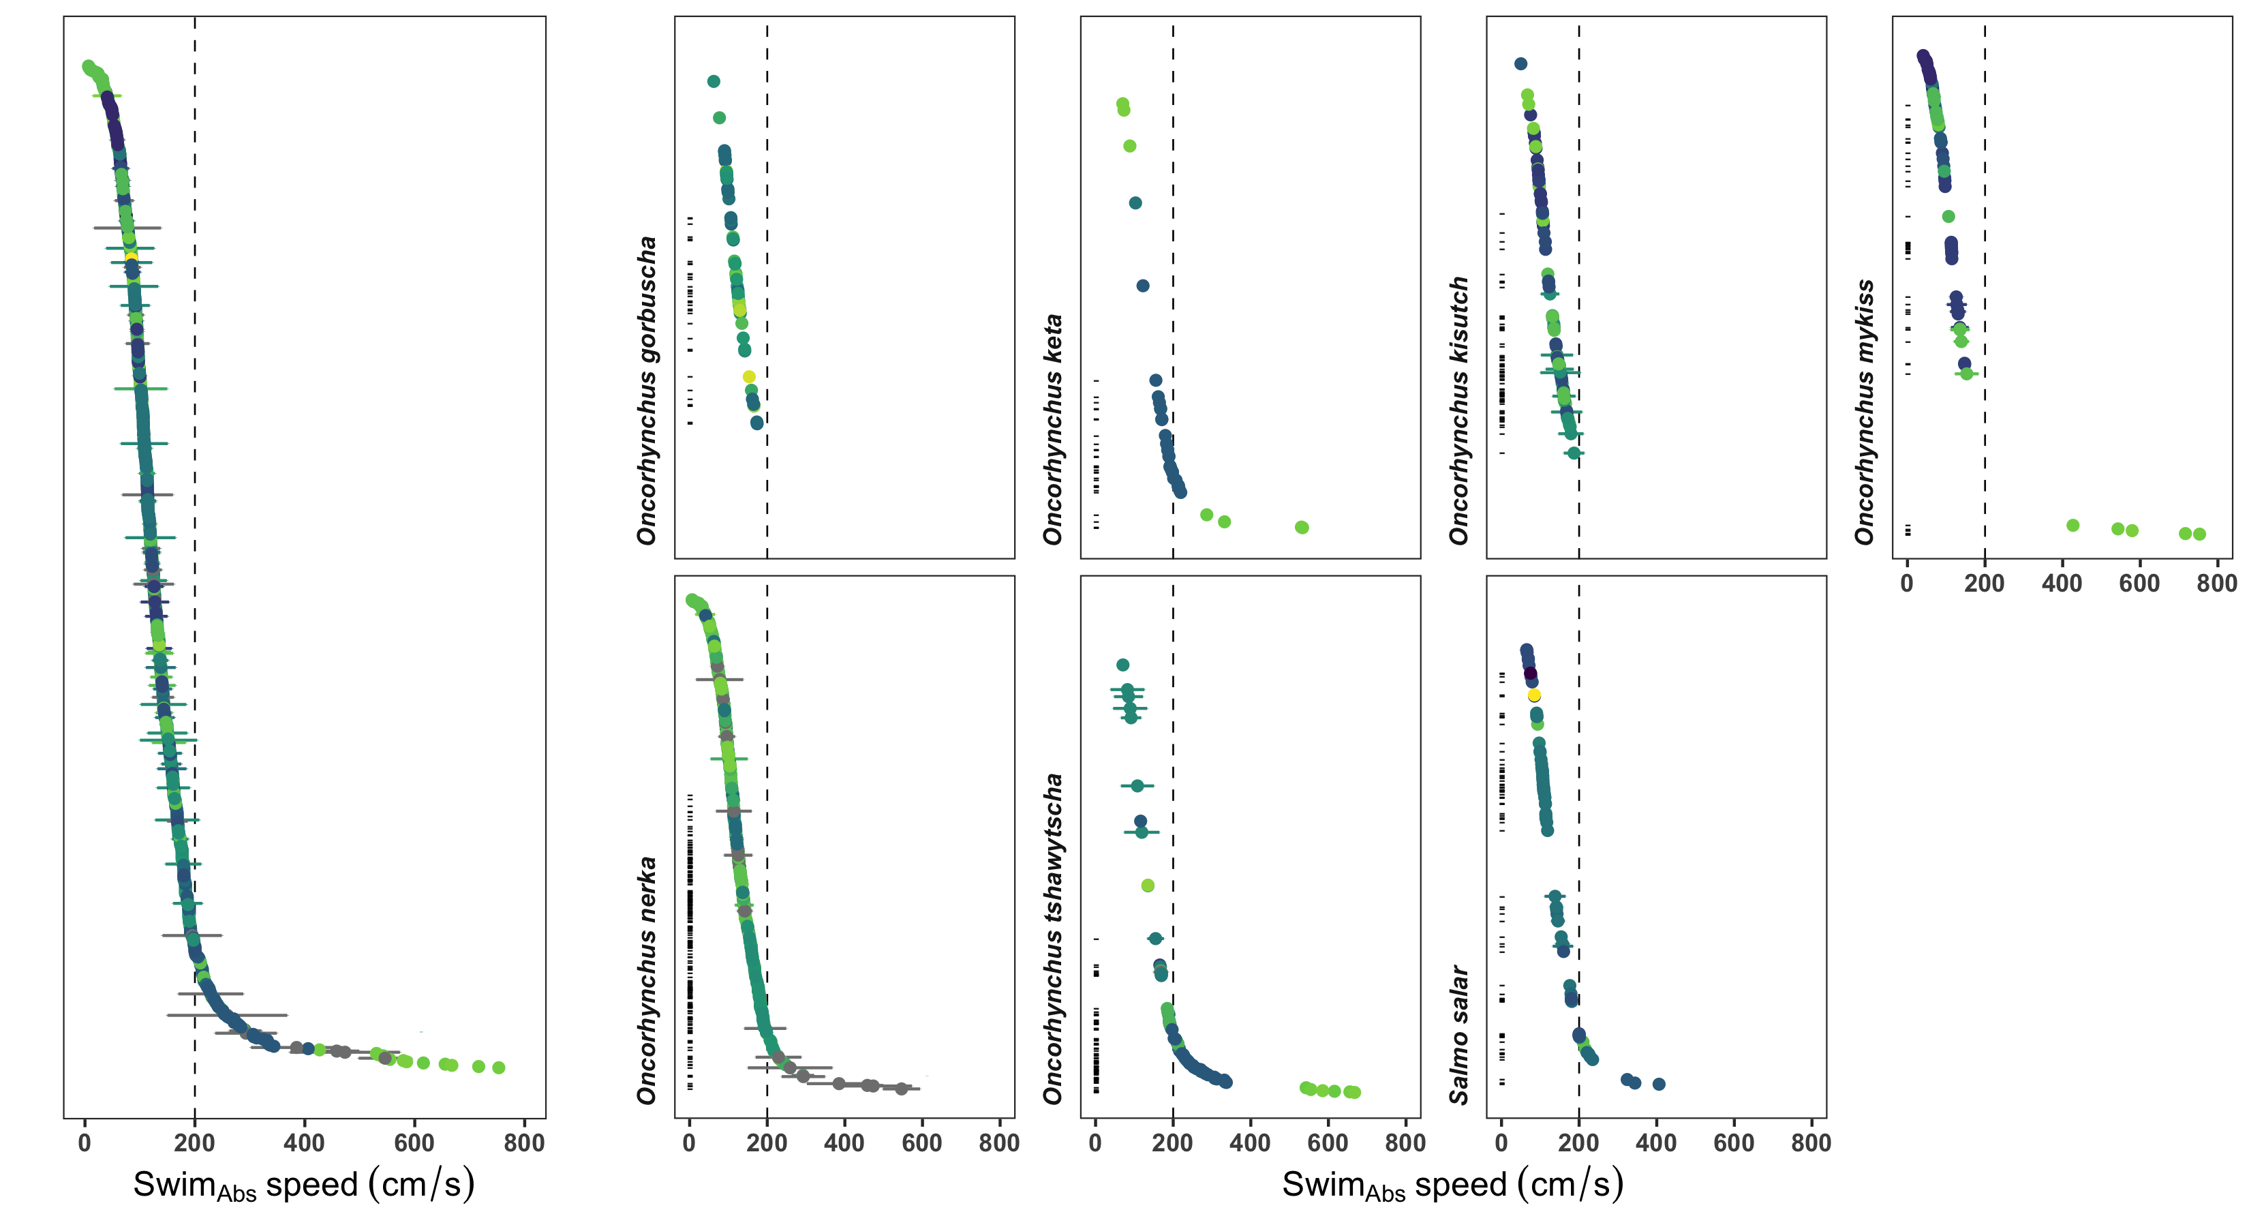


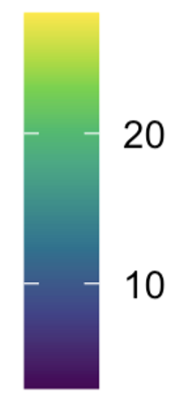
All data
combined
Max = 199 cm/s
Max = 533 cm/s
Max = 187 cm/s
Max = 817 cm/s
Max = 749 cm/s
Max = 668 cm/s
Max = 406 cm/s
Temperature
: marks estimated anaerobic (> 2 BL/s) swim speeds
Error is SD

Slide 8
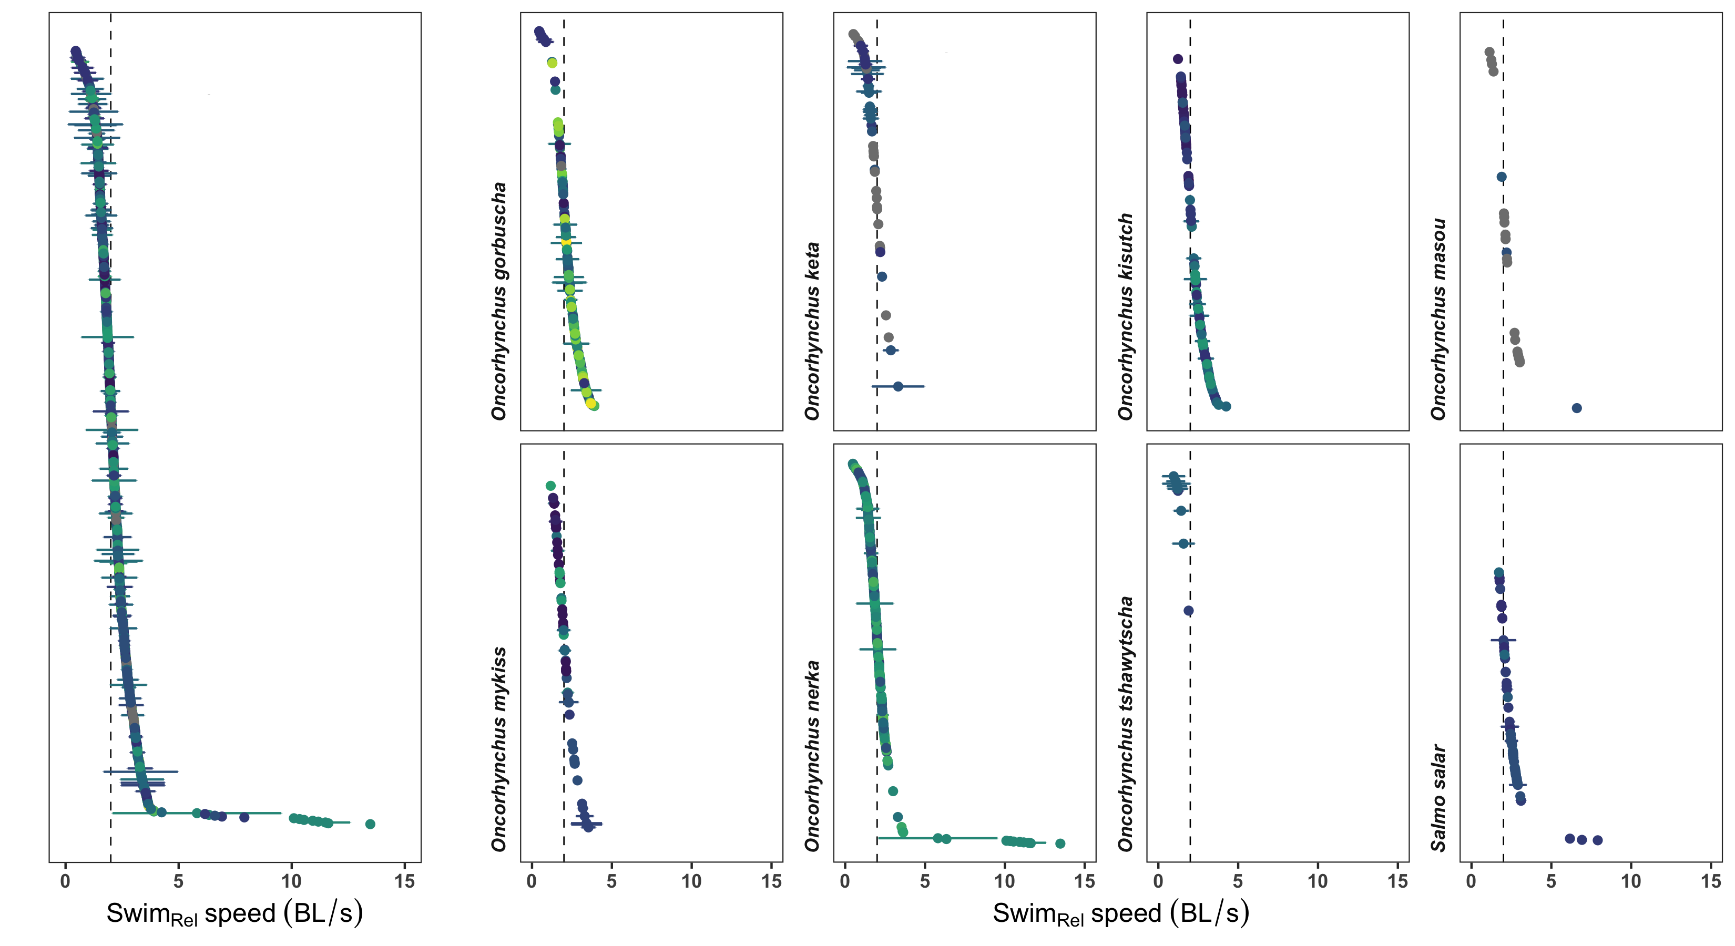
All data combined
Max = 3.90 BL/s
Max = 3.32 BL/s
Max = 4.25 BL/s
Max = 6.6 BL/s
Temperature
Max = 3.53 BL/s
Max = 13.5 BL/s
Max = 1.9 BL/s
Max = 7.91 BL/s

Slide 9
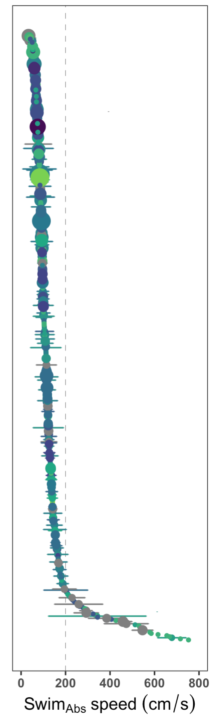
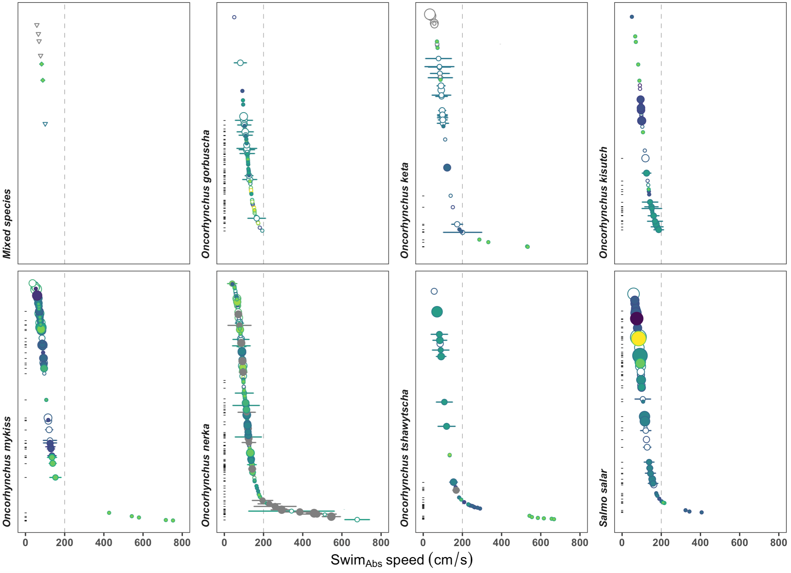
O. kisutch,
O. nerka combined
Max (reported) =
Max =
O. masou
estimated
reported
Max =
Max =
Max =
All species

Slide 10
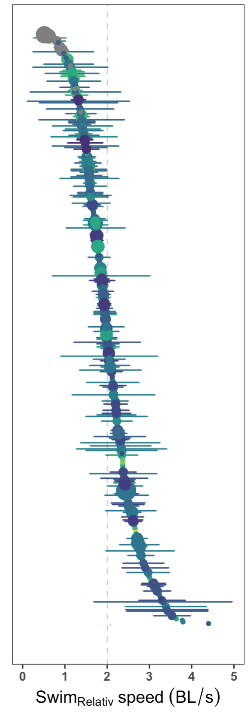
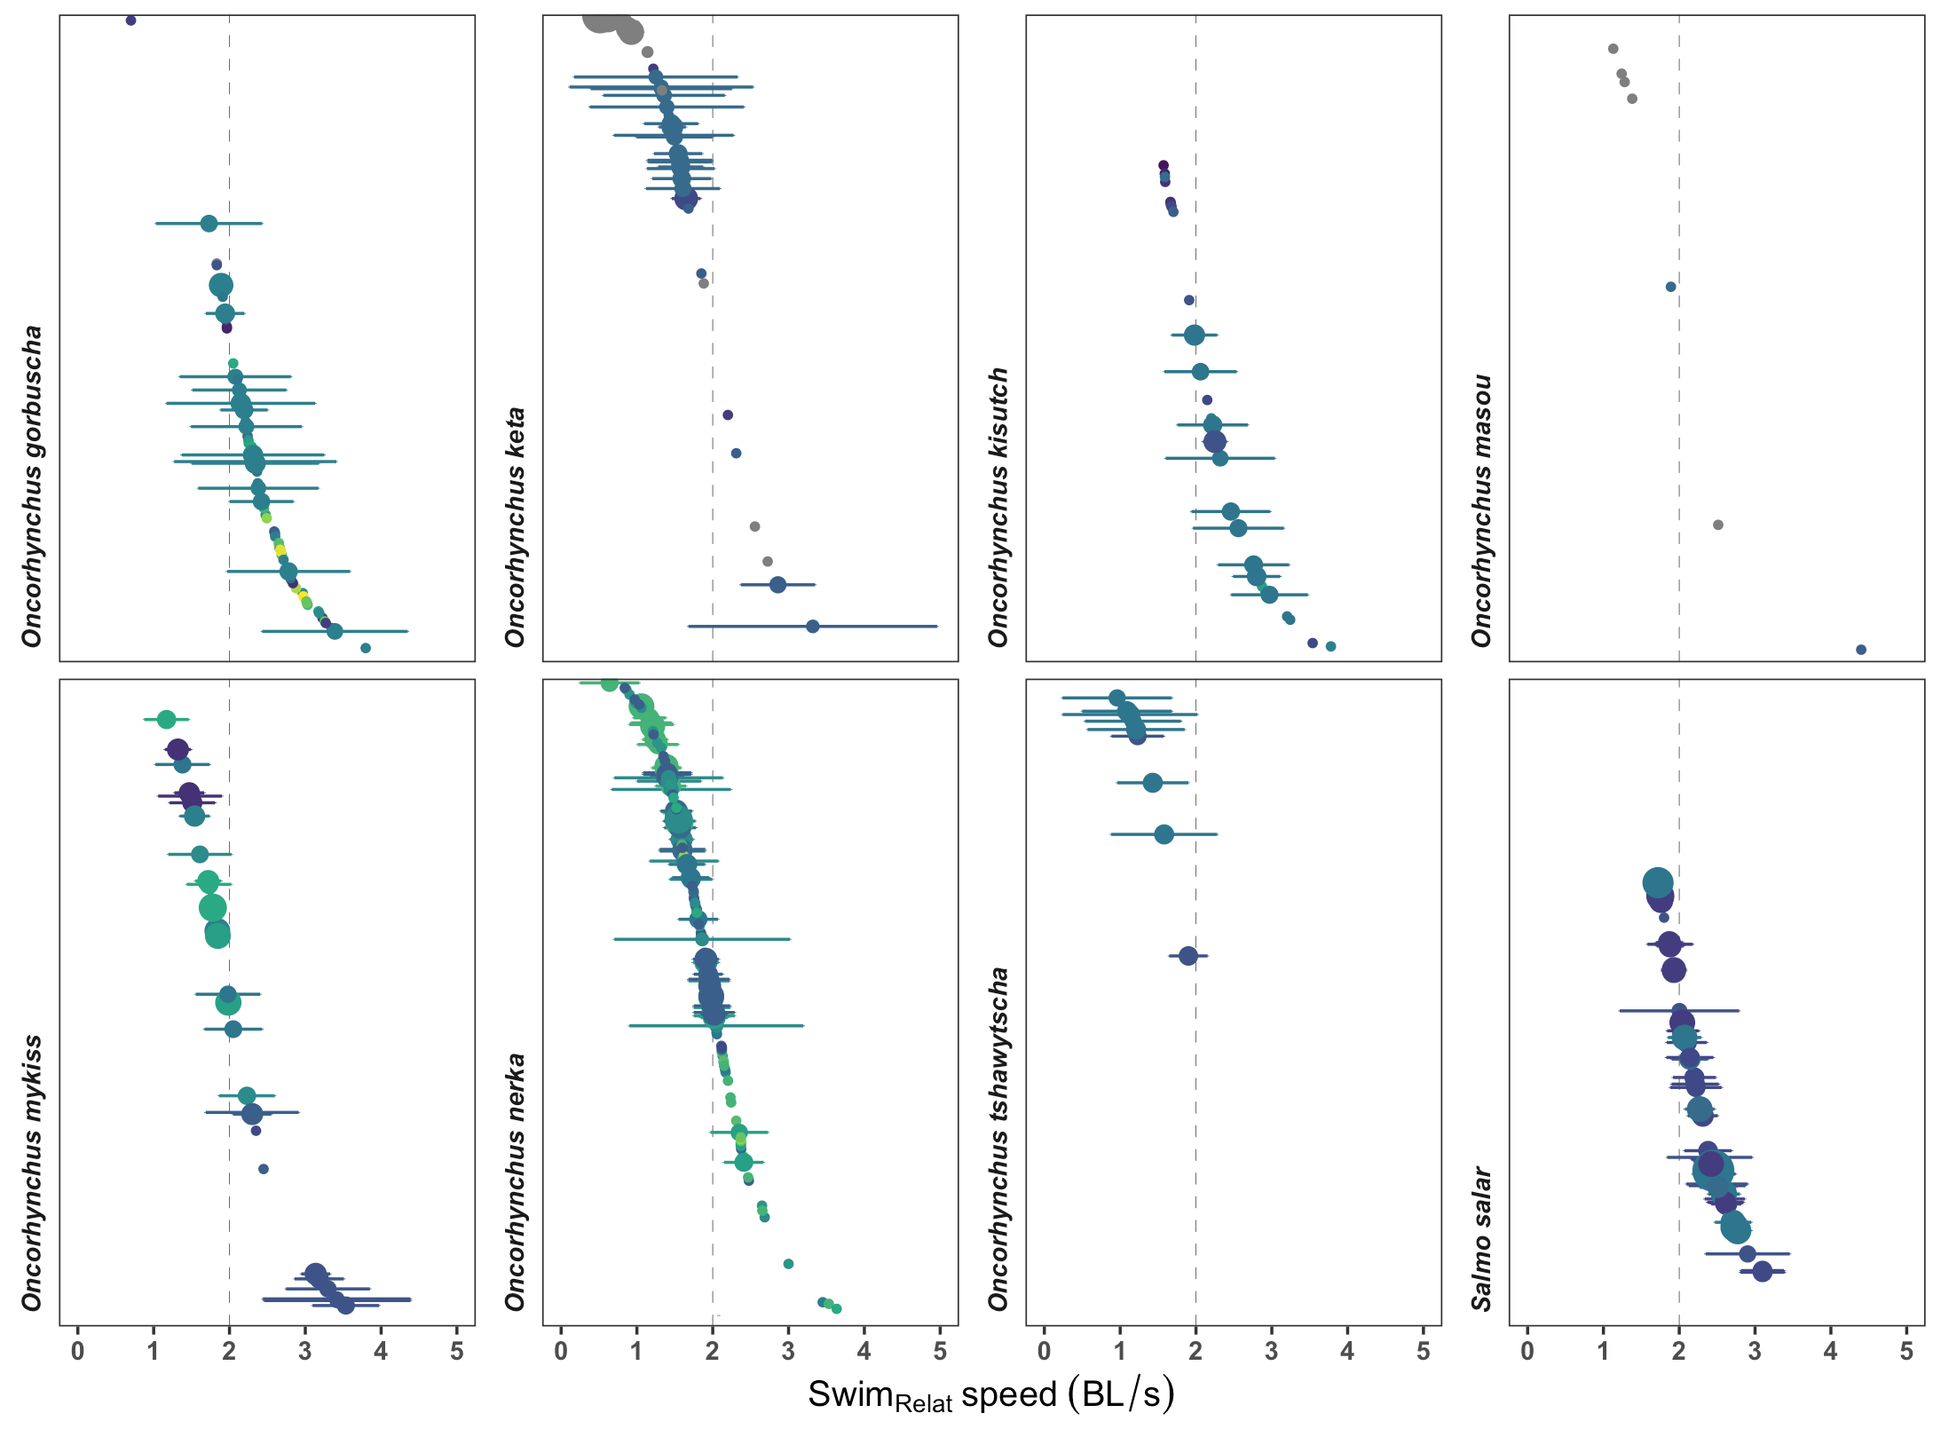
O. kisutch,
O. nerka combined
O. masou
reported
All species

Slide 11
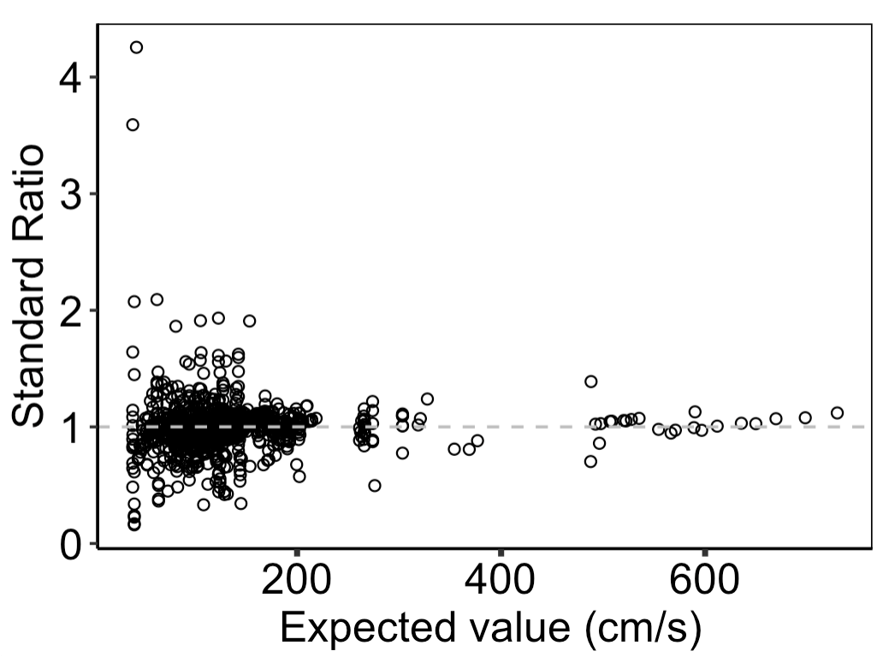
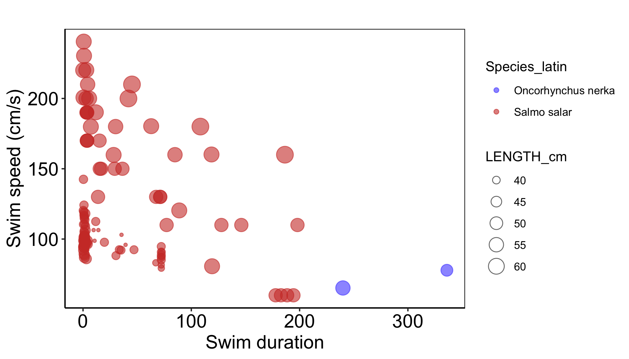

Slide 12
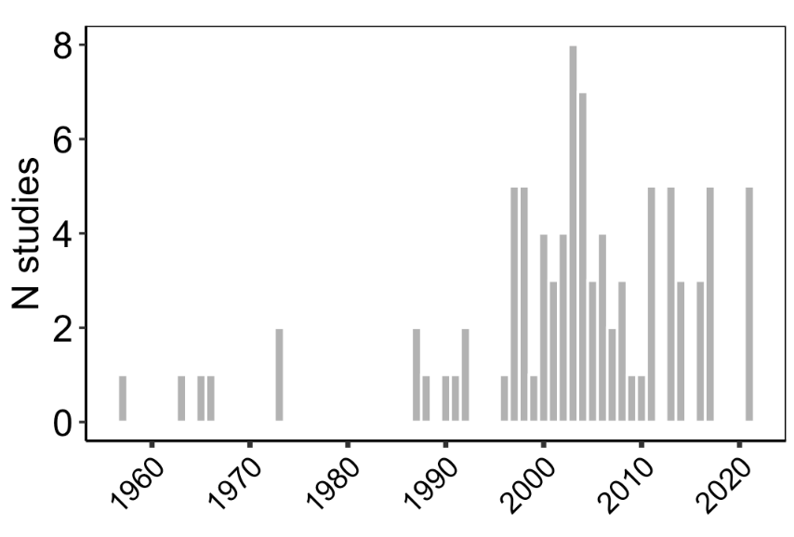

Slide 13
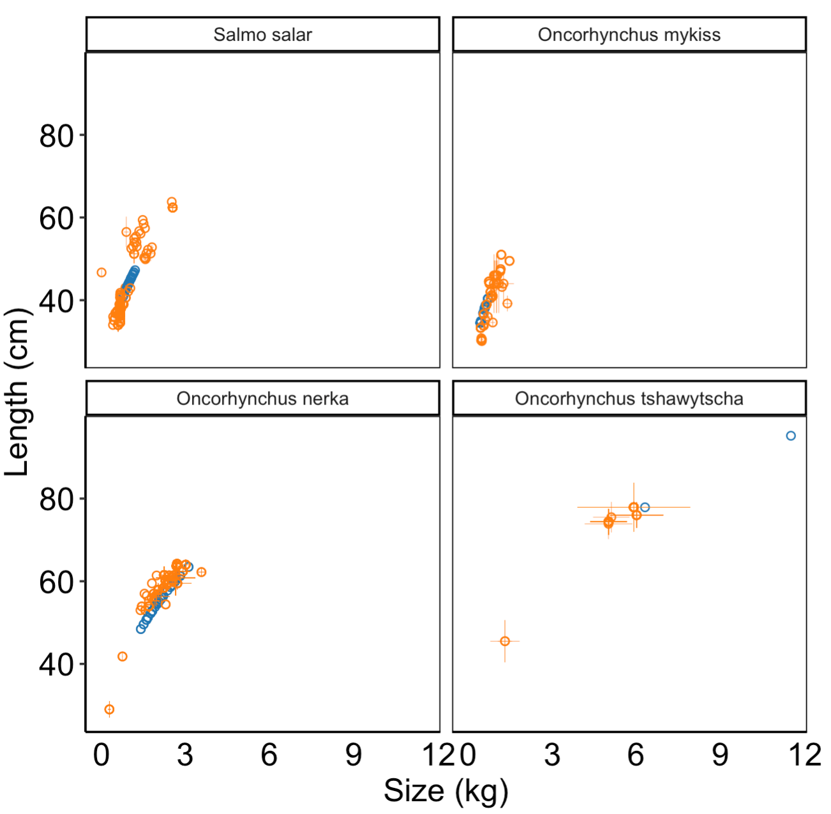
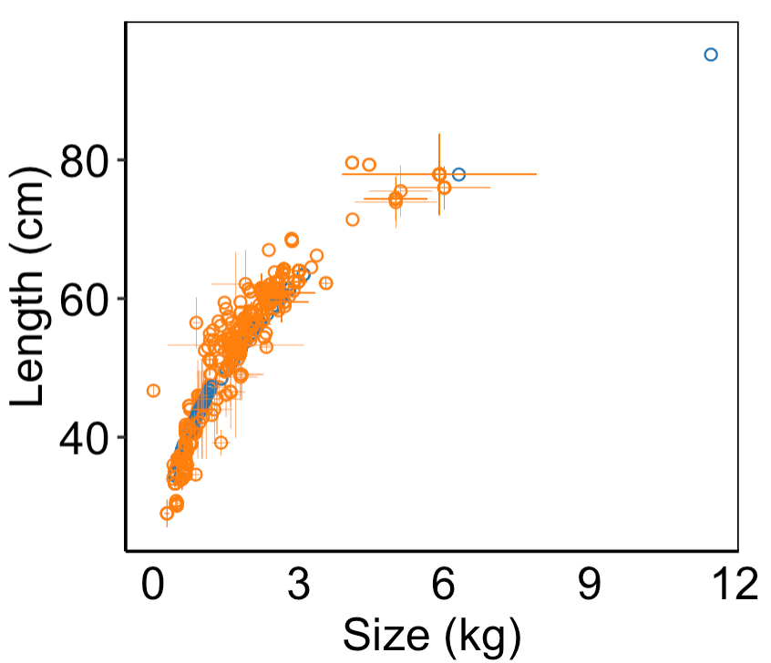
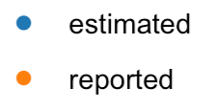
Weight = a * Length^{b}
Species | a | b
O. nerka | a = 0.01555 | b = 2.95
Salmo salar | a = 0.01047 | b = 3.02
O. tshawytscha | a = 0.01333 | b = 3.00
O. mykiss | a = 0.00955 | b = 3.03

Slide 14
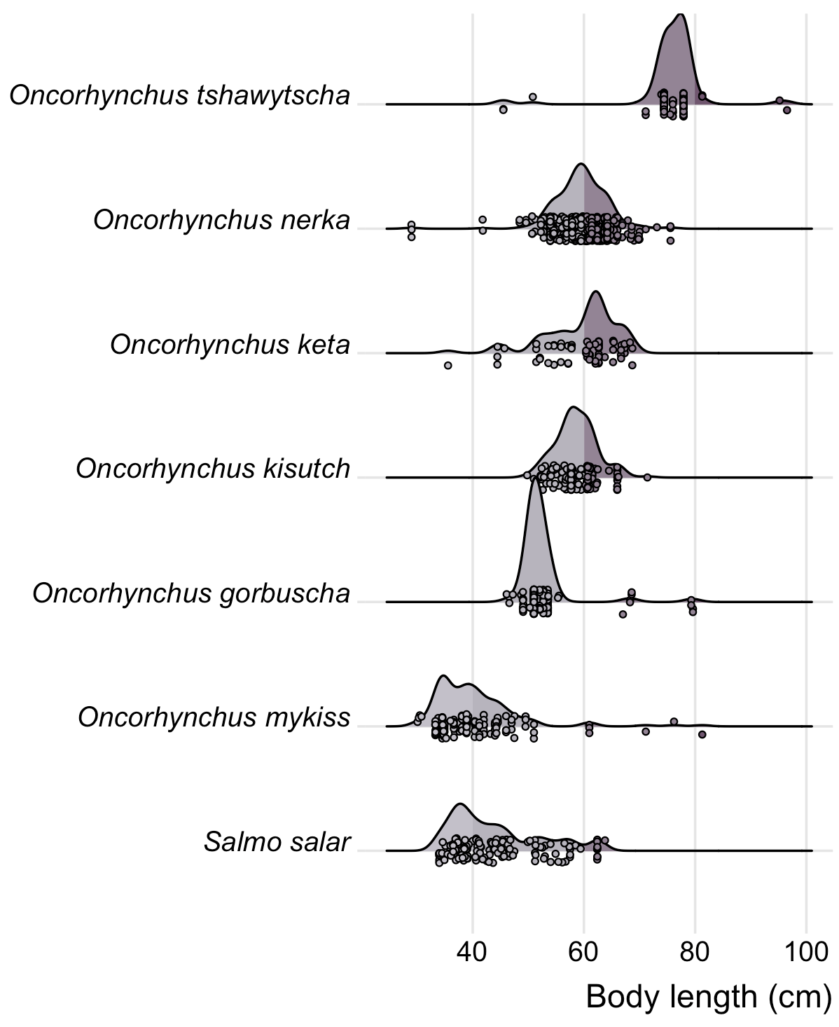
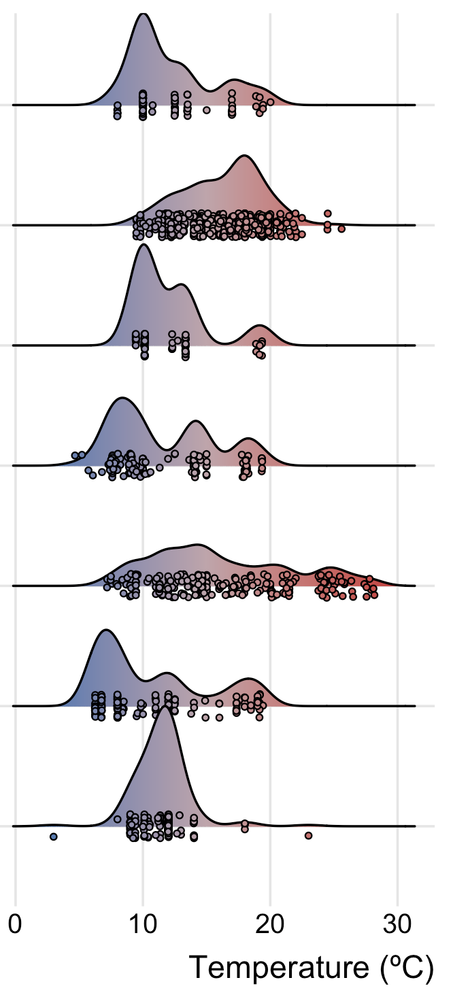
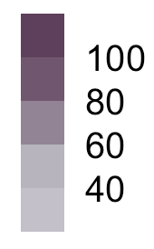
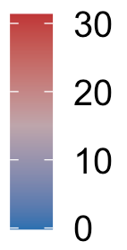
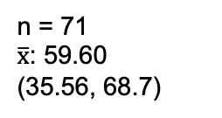
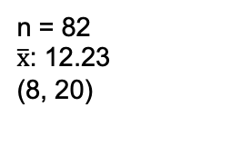
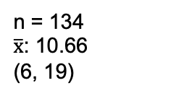
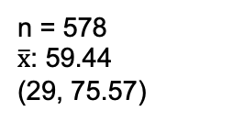
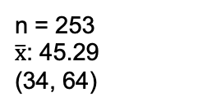
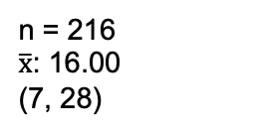
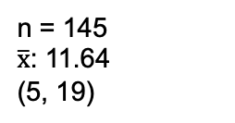
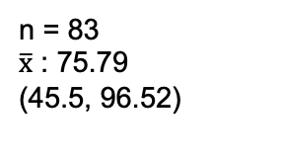
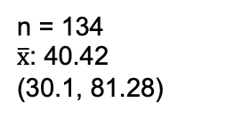
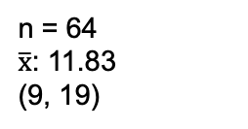
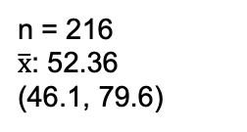
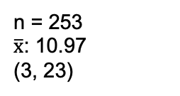
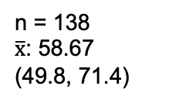
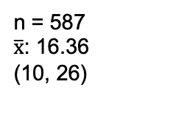
n = 83
$\overline{x}$ : 75.79
(45.5, 96.52)
n = 82
$\overline{x}$: 12.23
(8, 20)
n = 578
$\overline{x}$: 59.44
(29, 75.57)
n = 587
$\overline{x}$: 16.36
(10, 26)
n = 71
$\overline{x}$: 59.60
(35.56, 68.7)
n = 64
$\overline{x}$: 11.83
(9, 19)
n = 138
$\overline{x}$: 58.67
(49.8, 71.4)
n = 145
$\overline{x}$: 11.64
(5, 19)
n = 216
$\overline{x}$: 52.36
(46.1, 79.6)
n = 216
$\overline{x}$: 16.00
(7, 28)
n = 134
$\overline{x}$: 40.42
(30.1, 81.28)
n = 134
$\overline{x}$: 10.66
(6, 19)
n = 253
$\overline{x}$: 45.29
(34, 64)
n = 253
$\overline{x}$: 10.97
(3, 23)

Slide 15
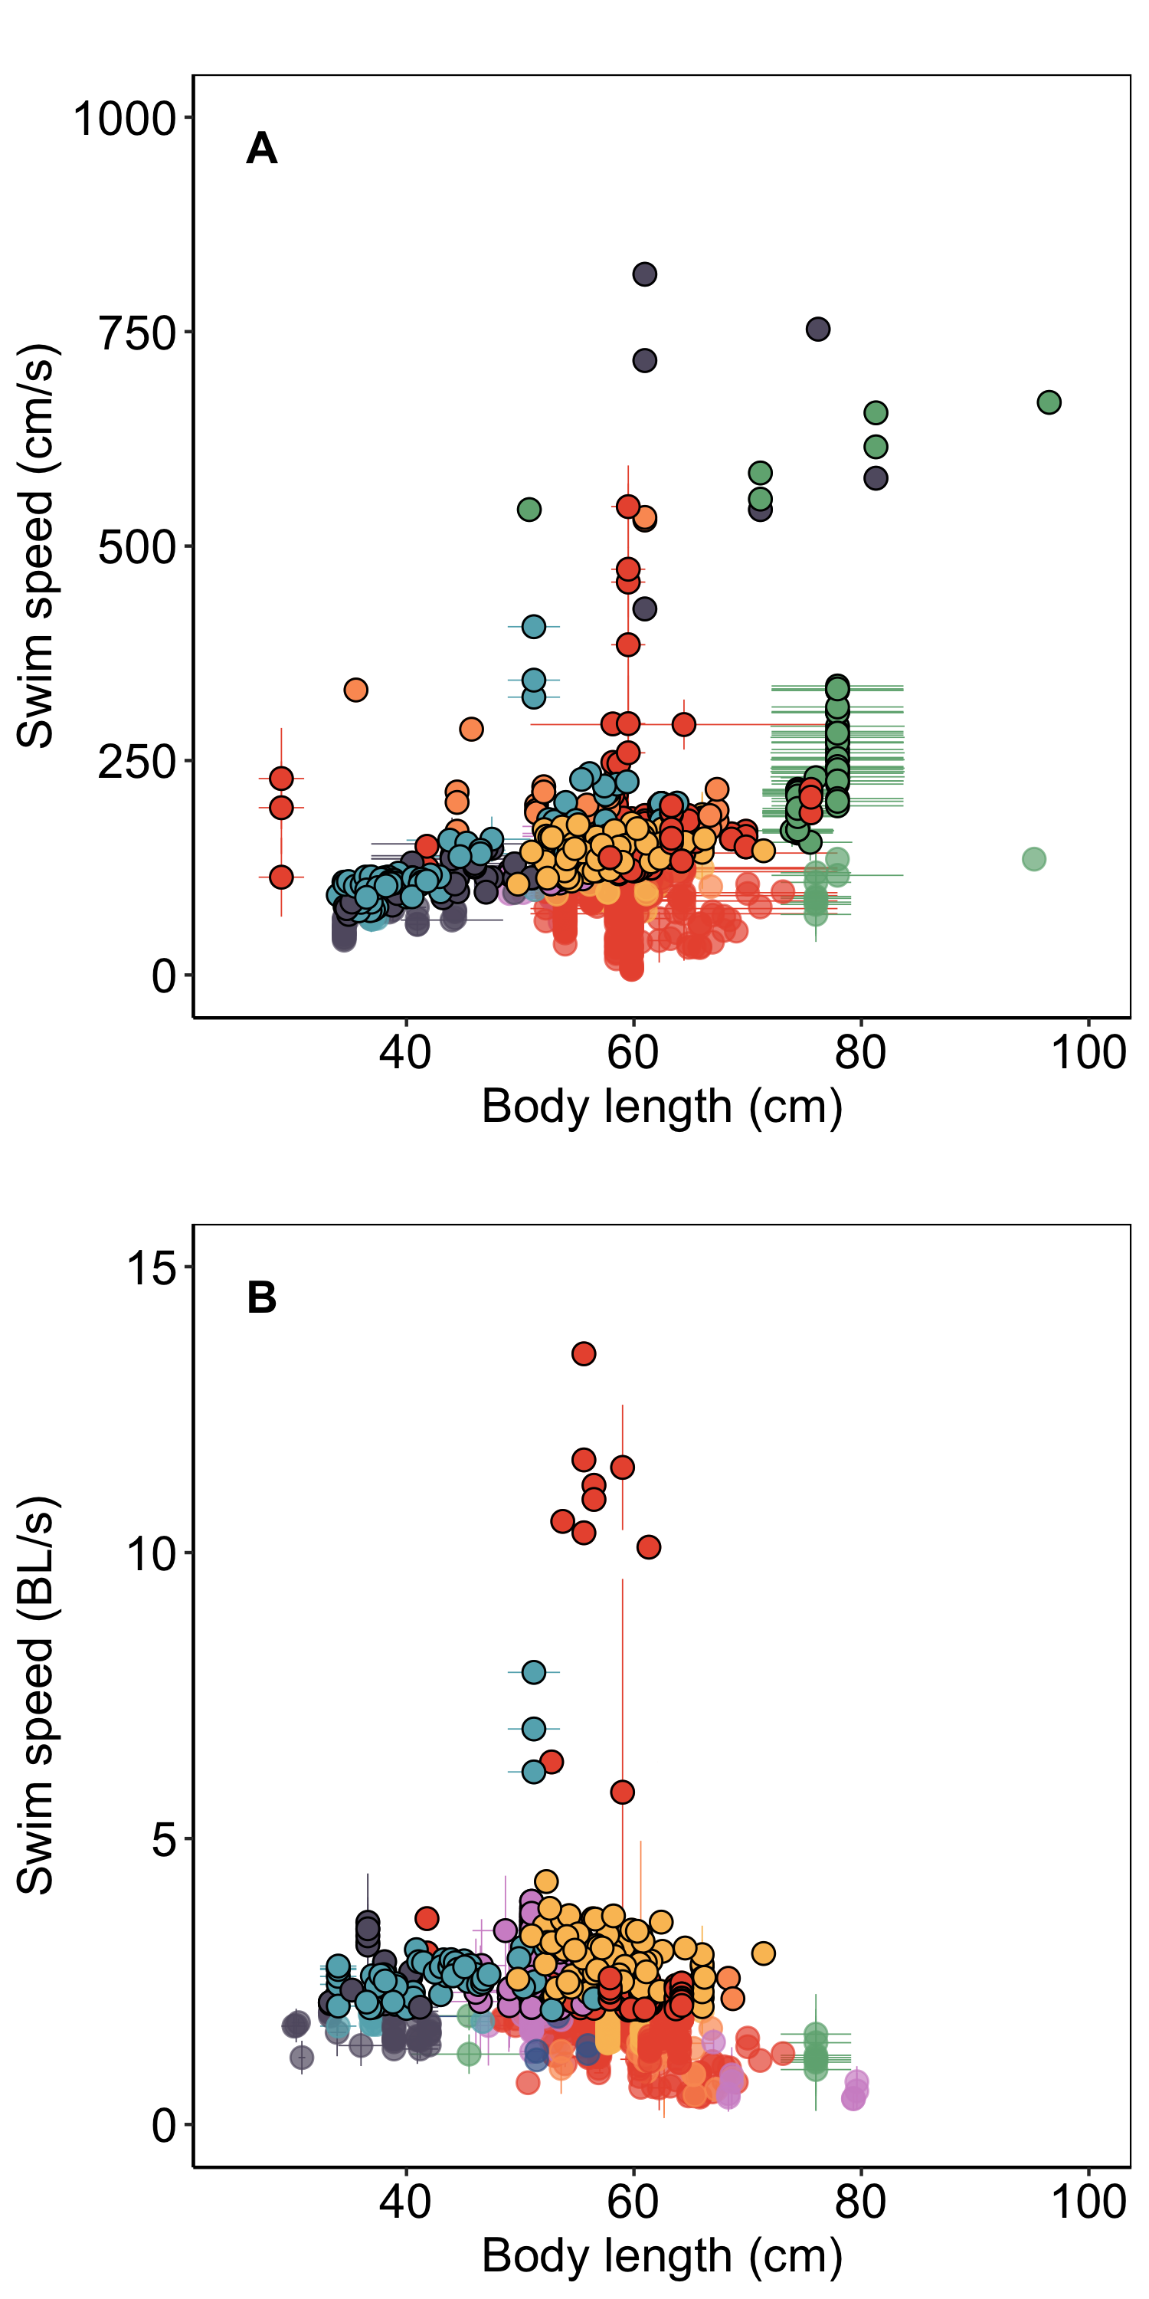
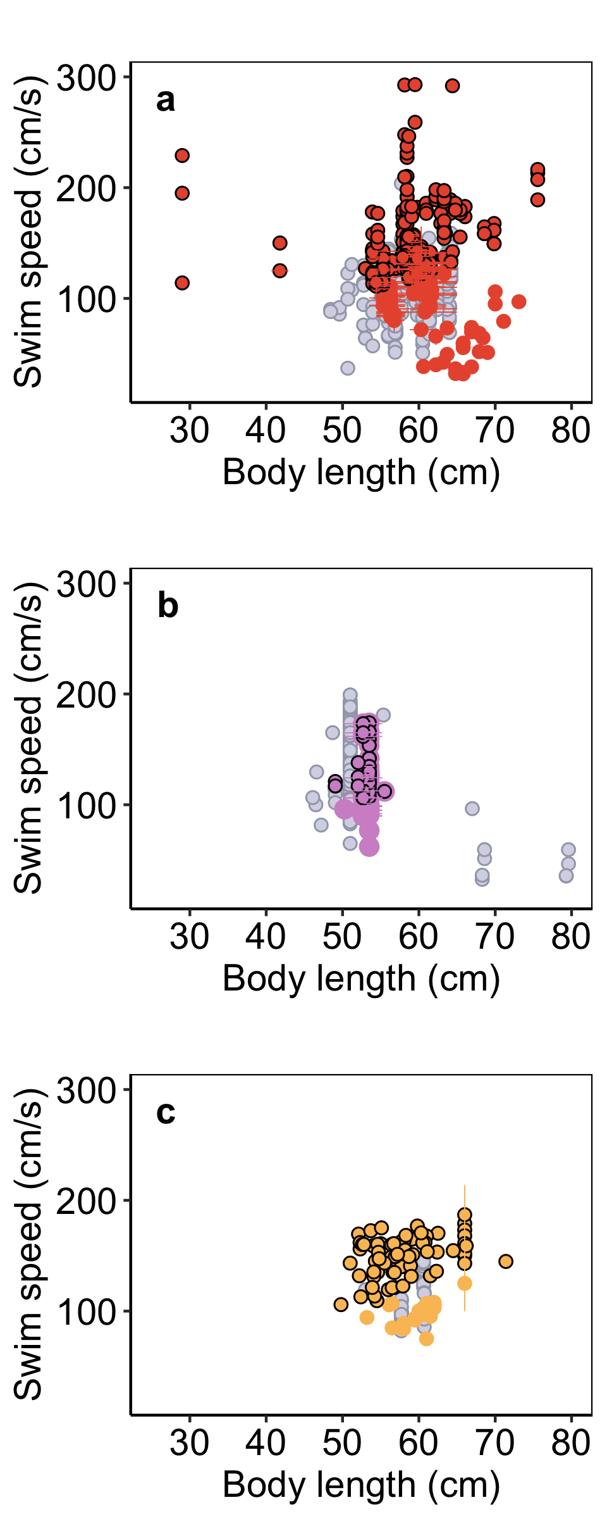
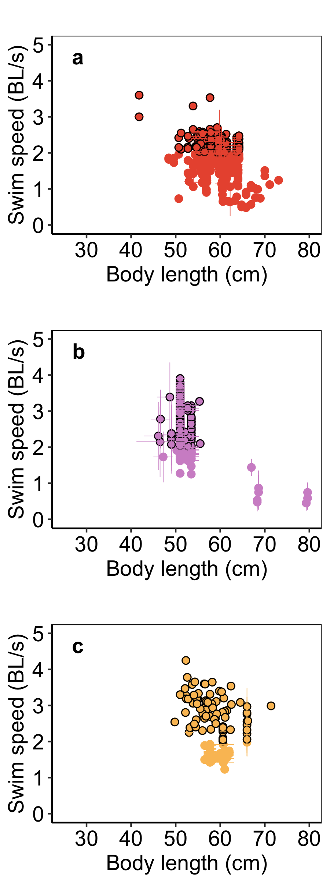

O. nerka
n =
O. gorbuscha
n =
O. kisutch
n =
BL/s > 5 (n=10)
O. nerka
n =
O. gorbuscha
n =
O. kisutch
n =

Slide 16



O. nerka
n =
O. gorbuscha
n =
O. kisutch
n =
BL/s > 5 (n=10)
O. nerka
n =
O. gorbuscha
n =
O. kisutch
n =

Slide 17

n =
n =
n =
n =
n =
n =
n =
n =
n =
n =
n =
n =
n =
n =
n =
n =
n =
n =
n =
n =
n =
n =
n =
n =
n =
n =
n =
n =
n =
n =
n =
n =
n =
n =
n =
n =
n =
n =
n =
n =
n =
n =
n =
n =
n =

Slide 18














Speed (all) = -37.18 + 2.86 * BL
Speed (< 250 cm/s) = 197.04 - 1.65* BL
Speed (> 250 cm/s) = 415.90 + 0.73* BL
Speed (all) = 78.75 + 1.91* BL
SPECIES- SPECIFIC RLEATIONSHIPS

Slide 19
















A
b
c
d
e
f
j

Slide 20




Slide 21



Slide 22



Speed = 78.746 + 1.914* BL
Speed = -32.699 + 7.311 * BL
Speed = -43.391 + 2.919 * BL

Slide 23
A
Estimated Swim_{Abs}
N = 624
(BL * Swim_{Relat})
Body Length (BL) Reported: N = 479
Swim_{Abs}
Swim
speeds
N = 1519
Directly reported Swim_{Abs} N = 895
Body Length Estimated:
N = 145
(Weight = a * Length^{b} )
a, b = Species specific coefficients
Swim_{Relat}
N = 986
B
XX Studies, n datapoints, other informative metrics? Just brainstorming
O. masou

Slide 24

SWIM SPEED cm/s
FISH
LENGTH
cm
WATER FLOWS
cm/s
GONADO-SOMATIC INDEX
TEST TEMP. ºC
GONAD MASS
g

Slide 25


Sex

Slide 26

Sex

Slide 27


